Slide 1
Pinterest - A case study
Nitte Meenakshi Institute of Technology
(AN AUTONOMOUS INSTITUTION AFFILIATED TO VISVESVARAYA TECHNOLOGICAL UNIVERSITY, BELGAUM)
PB No. 6429, Yelahanka, Bangalore 560-064, Karnataka
Telephone: 080- 22167800, 22167860
Fax: 080 - 22167805
Department of Computer Science and Engineering
Introduction to Cloud Computing (18CSE539)
Case Study presentation on
Presented by
Madhumitha R - 1NT19CS103
Shreya Shettar - 1NT19CS181
Tejashree K Murthy - 1NT19CS200
Meghana Reddy - INT19CS113
Guided by
Ms. Mamatha Bai B G
Asst. Professor
Dept. of CSE, NMIT

Slide 2
Pinterest - a case study

Slide 3
SOCIAL NETWORK CLOUD
What is cloud?
What is Social Cloud?
Notes:
Madhumitha
Social networking cloud (also called peer to peer social cloud computing), is an area of computer science that generalizes cloud computing to include sharing, bartering nd renting of computing resources.

Slide 4
PINTEREST
What is Pinterest?
Notes:
Tejashree
One of the most important social media marketing platforms is Pinterest. Even though it may not be as popular as Facebook, Twitter, or LinkedIn, Pinterest certainly has its potential to connect with a huge target audience.

Slide 5
52 Billion$
478 MILLION monthly users
200 Billion pins
That’s a lot of money
And a lot of users
Total success!
Notes:
Tejashree - As one of the most popular social media sites in the world, Pinterest currently has 478 million monthly active users (Pinterest, 2021). Analysts frequently compare Pinterest to other social networks like Meta's (NASDAQ: FB) Facebook and Instagram. However, Pinterest's shoppable pins, which encourage retailers to upload their entire catalogs to its pinboards, could gradually transform its network into an e-commerce platform.
That's why big retailers like IKEA upload their print catalogs to Pinterest and Shopify (NYSE: SHOP) partnered with Pinterest to enable smaller merchants to launch shoppable pins with integrated payment options. That's also probably why PayPal was reportedly interested in buying Pinterest for about $45 billion earlier this year.

Slide 6
User Motive Statistics
Event and party ideas
Beauty/
Clothing
Home Decor/ Design Inspiration
Travel

Slide 7


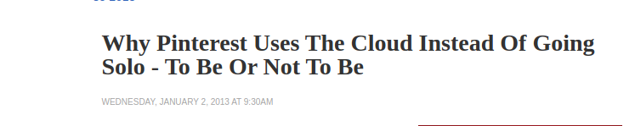
Notes:
Tejashree - Like many other large Amazon Web Services customers, Pinterest at times has struggled to accurately forecast its cloud capacity needs in advance, causing it to pay for additional capacity at a higher price.
Using AWS, Pinterest has tripled its use of storage and compute over just two years without worrying about reliability or scalability. Pinterest provides one of the world's largest visual-bookmarking tools, with around 1 billion users and 2 billion boards. The company has used a variety of AWS services to scale its processing, storage, and data-analysis workloads to help developers focus on delighting users.

Slide 8
Research Paper 01 - Cloud the mainstay : Growth of social networks in mobile environment
Methodology :
Mobile Cloud Computing (MCC)
Usage of Cloud :
Cloud computing for mobile devices.
high performance social networking, intensive operations on cloud.
Implementation :
Impact of cloud on social networks in mobiles.
The efficiency of usage and performance in mobile environment.
Notes:
Tejashree
What is Mobile CLoud Computing?
What is SOcial Computation cloud? Social storage cloud? Social collaborative cloud? Social cloud for public science? Enterprise social cloud

Slide 9
Research Paper 01 - Cloud the mainstay : Growth of social networks in mobile environment
Result :
-> A social computation cloud;
-> A social storage cloud;
-> A social collaborative cloud;
Summary :
This paper presents the impact of Cloud on social networks in mobile environment with detailed analysis.
This work acts as a measuring tool for the service provider to understand the future trend of mobile usage & encourage all the stakeholders to enhance services to be more reliable and highly secure.
The analysis presented in this work shows the wide acceptance of Social Cloud in mobile environment.
Notes:
Tejashree
What is Mobile CLoud Computing?
What is SOcial Computation cloud? Social storage cloud? Social collaborative cloud? Social cloud for public science? Enterprise social cloud

Slide 10
Research Paper 02- Image-centric social discovery using Neural Network Under anonymity constraint
Methodology :
->Focus on preserving the privacy of the shared images and user profiles outsourced in the cloud
->Provide secure social discovery.
Usage of Cloud :
->Recommender systems
-> Neural Networks for Social Discovery
Implementation :
->Convolutional Neural Network
->Use the extracted features to interact between user and the cloud server.
Notes:
Tejashree
WHat is Convolutional Neural Network?

Slide 11
Research Paper 02- Image-centric social discovery using Neural Network Under anonymity constraint
Result :
->Protects the outsourced images.
->Enables efficient search over the anonymized data.
->Data utility is preserved after anonymization.
Summary :
-> The paper presents a framework for privacy preserving image-centric social discovery.
-> The proposed design provides a solution to two challenges – storing images in the semi-honest cloud infrastructure and providing social discovery by the nearest neighbour search on anonymized data.
-> The designed framework not only protects the images uploaded by the user but also enables efficient search over the anonymized data preserving it’s utility.

Slide 12
Research Paper 03 - Social Cloud: Cloud Computing in Social Networks
Methodology :
->Using friend relationships within a social network to form a Social cloud and enable resource sharing and storage.
Usage of Cloud :
->Storage Cloud
->Social network cloud
Implementation :
->prototype utilizes Web Services to create a scalable, distributed and decentralized infrastructure.
->prototype provides transparency by reducing user information from storage access to preserve accountability.
Notes:
Tejashree

Slide 13
Research Paper 03 - Social Cloud: Cloud Computing in Social Networks
Result :
Users can discover and trade storage services contributed by their friends, taking advantage of pre-existing trust relationships.
Summary :
propose leveraging the pre-established trust formed through friend relationships within a Social network to form a dynamic “Social Cloud”, enabling friends to share resources within a Social network. This paper has presented the implementation of a Social Cloud; an amalgamation of Cloud Computing, Volunteer Computing and Social networking. In this proposed system, Pinterest, Facebook users can discover and trade storage services contributed by their friends, taking advantage of pre-existing trust relationships.
Notes:
Tejashree

Slide 14
Research Paper 04- AMAZON REKOGNITION
Methodology :
Cloud based SaaS computer vision platform.
Uses deep learning to analyze photos and images.
Important tool behind Pinterest Lens.
Usage of Cloud :
Uses APIs to perform analysis on any picture or video file
These files are stored in Amazon S3 ( Amazon cloud storage service)
Uses reinforced learning to provide accurate search results
Implementation :
Creates a database of videos and stored images where the user has the capability to search and analyze so one can establish new trends from the content.
It has various applications as described in the following slide.
Result :
prides itself on its facial recognition capabilities.
It has changed the game for Entrepreneurs/startups
Helps budding developers and students to integrate this into their projects.
Summary :
Amazon Rekognition enables the user to integrate picture and video analysis to an application using deep learning technology which is very simple to use.
With this technology, one can identify people, activities, objects, text, and scenes in images and videos, as well as can identify any inappropriate content
Notes:
Madhumitha

Slide 15
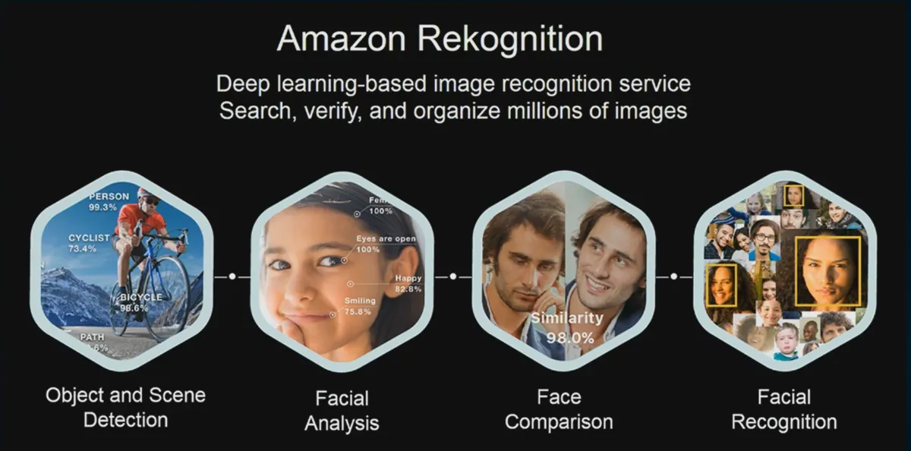
AMAZON REKOGNITION
Notes:
Madhumitha

Slide 16
Research Paper 05 - Pinterest as a Marketing Tool
Methodology :
Social media, potential as a marketing channel
Increased interest in using social media platforms for online and traditional businesses.
Businesses are using social media sites to promote and market products, engage customers, and create brand loyalty. Eg: Nike,Channnel,H&M etc
Usage of Cloud :
Clustering algorithms in Big Data are used to find the present trends
Improved web technologies and design to distinguish themselves from other brands/companies.
TAM model that predicts use and interaction of technology systems.
Notes:
Madhumitha

Slide 17
Research Paper 05 - Pinterest as a Marketing Tool
Implementation :
The hypothesis being: The higher the level of user-platform fit, the stronger will be the positive association between usability and content and users’ affinity toward Pinterest.
Result :
The results of the study showed that user-platform fit, technical characteristics, design, and purchase intention constructs were important determinants of users’ affinity toward Pinterest.
Summary :
Pinterest offers tremendous potential for marketers because of niche appeal in a strong visual.Medium using antecedents of usability, design, user-platform fit, and media content of the Pinterest platform and has helped gain value loyalty and trust of brands.
Notes:
Madhumitha

Slide 18
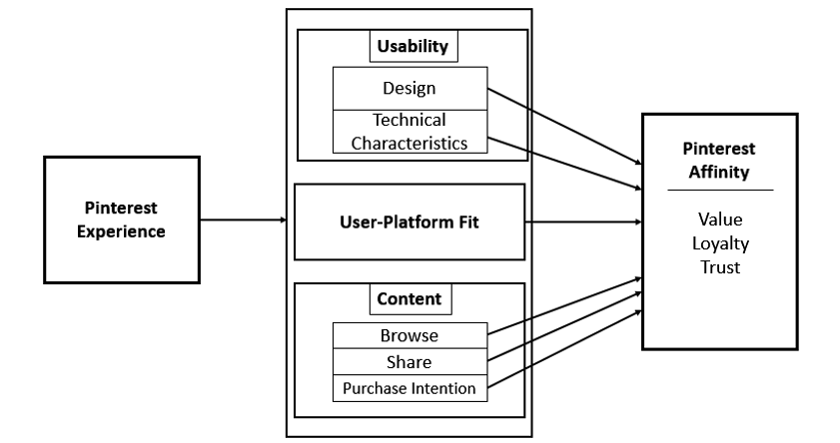
Research Paper 05 - Social Cloud Computing: A Vision for Socially Motivated Resource Sharing
Notes:
Madhumitha

Slide 19
Research Paper 06 - Social Cloud Computing: A Vision for Socially Motivated Resource Sharing
Methodology :
social networks provide a primary means of communication
A Social Network cloud is the process of allocating and sharing the resources of cloud within the social network members.
Done by combining the social networks processes and cloud computing concepts.
Usage of Cloud :
For predicting the the relationship between the friends Big data can be used.Amazon EC2 provides the great success in provisioning the infrastructure services and Microsoft azure have a success in provision-ing the platform services.By combining the concept of cloud computing and social network platform the resulting gives rise to an efficient application
Implementation :
To compute resources we use the social cloud platform associated with various modules,access control and database as shown in the figure.
Result :
The allocation and sharing of resources can be possible in an innovative way, by combining the social networks processes and cloud computing concepts
. Using this, users are able to execute their programs on virtualized resources provided by their friends from their own devices like personal computers, smart phones etc.
Summary :
In this paper, the social network cloud: a platform which enables the sharing of infrastructure resources and software resources between friends through digitally encoded social relationships. Using this, users are able to execute their programs on virtualized resources provided by their friends from their own devices like personal computers, smart phones etc
Notes:
Madhumitha

Slide 20
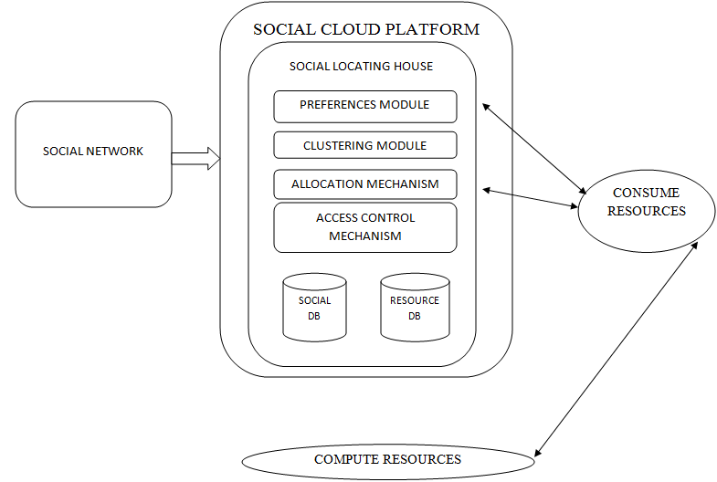
SOCIAL CLOUD PLATFORM
Notes:
Madhumitha

Slide 21
Research Paper 08- The pin-bang theory-discovering the pinterest world
Methodology :
Investigating Pinterest from a privacy and security standpoint,
Analysis on how Pinterest is a potential venue for copyright infringement
Usage of Cloud :
Pinterest uses aws to house its enormous amount of user data and images
Image Recognition for recommendations and easier search of pins
Implementation :
-> initial seeds
->feed seed into crawler
->crawl through
->user data collection
->pin data collection
->perform analysis
->analyse security and privacy of pinterest
Result :
and found traces of malware in the form of pin sources.
Instances of Personally Identifiable Information (PII) leakage were also discovered
Summary :
Through focused analysis on the security and privacy issues on Pinterest it was found that numerous instances of PII leakage through users’ description field had occurred.
Though the information is shared voluntarily by users,the all public nature of the network makes users potentially more vulnerable to third-parties extracting and using this information for marketing and other purposes.
Notes:
Shreya
How copyright infringement? Seeds? Crawler? What user data is collect? What pin data is collected? PII meaning? How data which is willingly shared also a vulnerability?

Slide 22
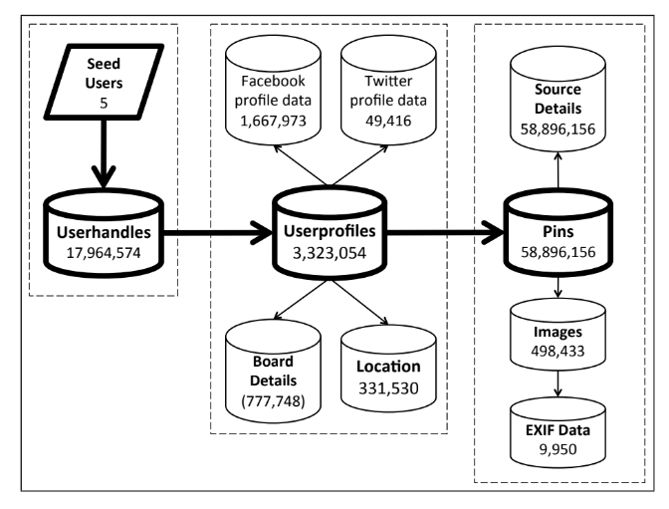
Research Paper 08- The pin-bang theory-discovering the pinterest world
Notes:
Shreya
How copyright infringement? Seeds? Crawler? What user data is collect? What pin data is collected? PII meaning? How data which is willingly shared also a vulnerability?

Slide 23
Research Paper 09 -Building virtual anonymized databases for the Cloud
Methodology :
R*-tree for anonymization (using a k- concealment model).
integration of local generalized data for anonymity
Usage of Cloud :
The R* tree algorithm is deployed in cloud- since data and computing capacity are of larger scale
Implementation :
a centralized version of anonymization algorithm is implemented in order to generate a secure and distributed anonymization among cloud servers.
Summary :
addresses two important issues, privacy of data subjects and privacy of data providers
k-concealment model offers a higher utility with less generalisation
We also illustrated that the R*-tree strategy leads to an effective insertions and splitting .
Result :
each private dataset produces a local anonymized dataset that satisfies all the privacy constraints
and their union forms a global virtual database
This embodies global anonymization principle (k-concealment).
Notes:
Shreya
R* tree? K concealment? Distributed anonymisation? How does r* tree work? How is the structure proposed working?

Slide 24
Research Paper 10- A Statistical Overview of Pinterest
Methodology :
Quantitative and statistical techniques are used to examine the possible behaviours on Pinterest.
Usage of Cloud :
Fine Grain Access Control (FGAC) is developed by AWS and Pinterest to store Pinterest’s data on the cloud on S3.
Using AWS, Pinterest has tripled its use of storage and compute over just two years without worrying about reliability or scalability.
Implementation :
->obtain the data
->prepare the data for analysis
->usage of statistical methods- binomial regression, penalised logistic regression
Result :
most of the pinterest images were sourced by google or twitter,
likes and comments drive more repin,
being american or british earns repins,
women have fewer followers.
Summary :
provides a statistical overview of Pinterest.
main findings - being female on the site leads to more repins, while geography seems to play no role;
AWS services define the user experience of Pinterest.
Notes:
Shreya
FGAC- what? Structure in brief? Binomial regression? Penalised regression?

Slide 25
Conclusion
Pinterest Services
Pins and Boards
Recommendation system
Sharing of pins with other users
Privacy of user data
AWS
Cloud storage on S3
Amazon Rekognition
Social Cloud Network
Distributed Anonymization system
Notes:
Conclusion

Slide 26
REFERENCES
An Overview on Amazon Rekognition Technology- Raghavendra Kumar India-California State University San Bernardino
Building virtual anonymized databases for the Cloud-Salheddine Kabou,EEDIS Laboratory, Djillali Liabes University of Sidi Bel Abbes,Sidi Bel Abbes, Algeria
https://www.researchgate.net/publication/224242994_Social_Cloud_Computing_A_Vision_for_Socially_Motivated_Resource_Sharing
Image-centric Social Discovery Using Neural Network under Anonymity Constraint- 2017 IEEE International Conf on Cloud Engg
https://www.researchgate.net/publication/322966992_Determinants_of_Pinterest_affinity_for_marketers_using_antecedents_of_user-platform_fit_design_technology_and_media_content
Notes:
Conclusion

Slide 27
REFERENCES
Cloud the Mainstay: Growth of Social Networks in Mobile Environment(2013 International Conference)
The Pin-Bang Theory: Discovering The Pinterest World-Sudip Mittal, Neha Gupta, Prateek Dewan, Ponnurangam Kumaraguru
“I Need to Try This!”: A Statistical Overview of Pinterest-Eric Gilbert,,Shuo Chang, Loren Terveen
Social Cloud:Cloud Computing in Social Networks- 2010 IEEE 3rd International Conf on Cloud Engg
Notes:
Conclusion

Slide 28
THANK YOU!!
Presented by:
Madhumitha R
Shreya Shettar
Tejashree Krishna Murthy
Meghana Reddy

